Slide 1
General Health
The Health Triangle

Slide 2
What is health?
Health is the combination of….
Physical Health
Mental Health
Social Well-being

Slide 3
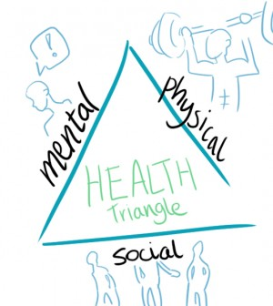

Slide 4
Physical Health
Physical Health addresses the body’s ability to function.
Engaging in physical activity everyday will help to build and maintain your PHYSICAL HEALTH.
Here are some ways you can improve your physical health:

Slide 5
Physical Health
Eating Healthy Foods
Visiting the doctor regularly
Caring for personal hygiene
Wearing protective gear
Get enough sleep
Resist harmful substances such as alcohol and drugs

Slide 6
Mental/ Emotional Health
Mental and emotional health examines how a person handles their feeling, thoughts, and emotions each day.
Here are ways a person can improve their mental/emotional health:

Slide 7
Mental/ Emotional Health
Share your thoughts and feelings with your family, a trusted adult or friend.
Talking and thinking about yourself in a healthful positive way.
Taking action to reach your goals
Make healthful choices, and keep your promises.
Take responsibility for what you do

Slide 8
Social Health
Social health measures the way a person reacts to people in their environment. It encompasses people at home, at school, and everywhere in your world.
Signs of good social health include:
Strong Friendships
Strong Family Relationships

Slide 9
Social health
Good social health includes supporting the people you care about. It also includes:
Communicating with people
Respecting People
Valuing People
You can disagree and express your thoughts, but be thoughtful and choose your words carefully

Slide 10
Total Health
Wellness- is a state of well-being or balanced health over a long period of time.

